Slide 1
Galaxy Zoo
galaxy classification
Danylo Sahaidak
Vitaliy Papka

Slide 2
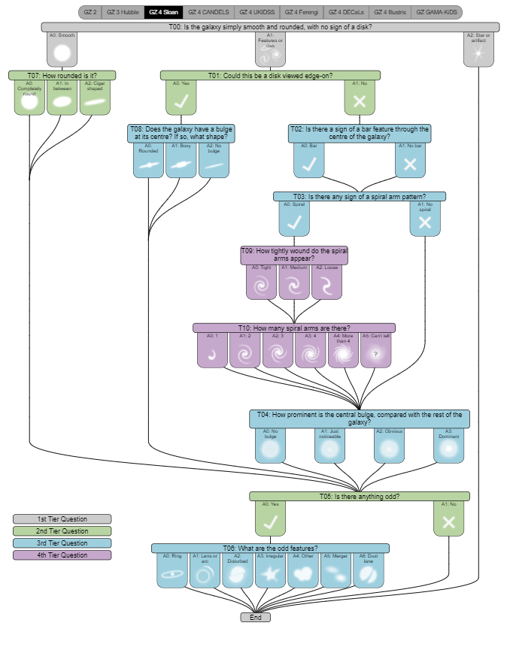
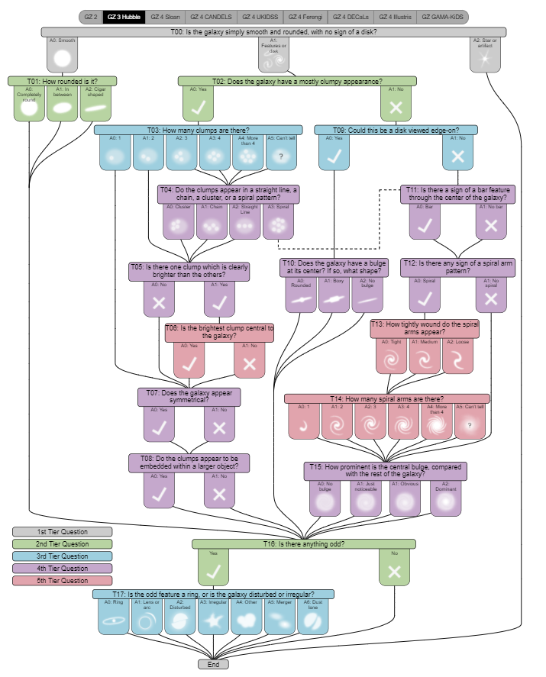
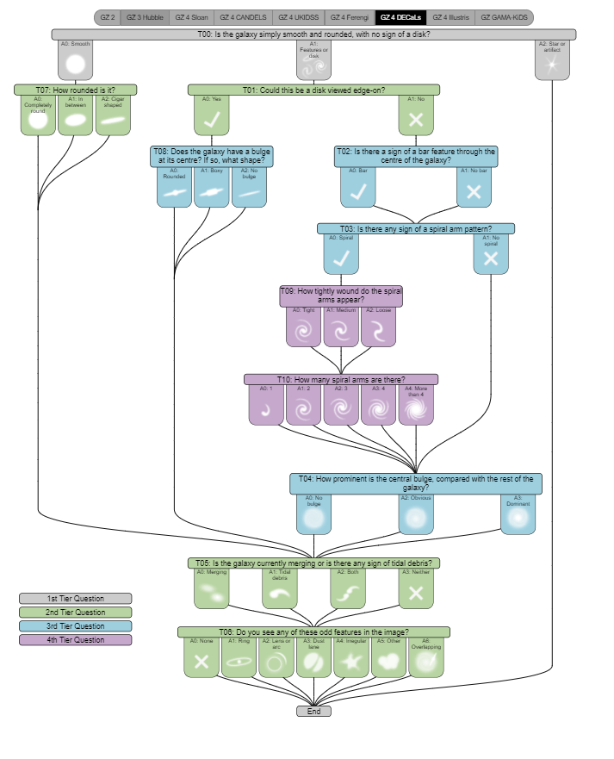
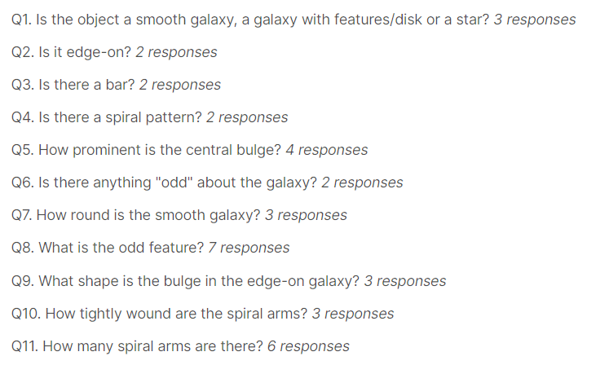
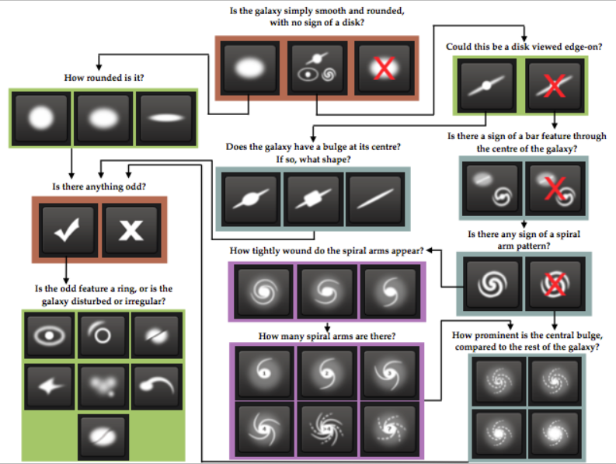
The challenge is to:
recognize the structure of the galaxy
classify galaxies by it’s photo

Slide 3



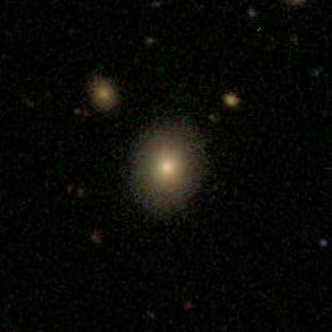
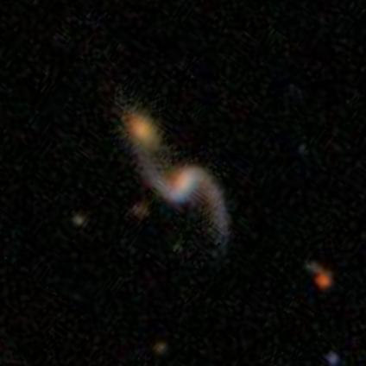
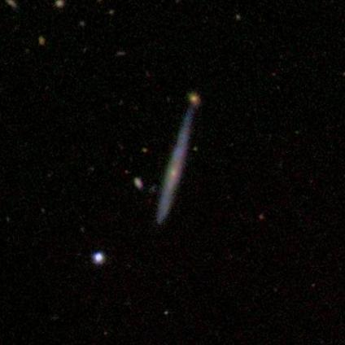
The dataset
Images of the galaxies from open source dataset of Sloan Digital Sky Survey manually labeled by volunteers in Galaxy Zoo project prepared for Kaggle Challenge
more than 60k galaxies images
every photo represents new different galaxy
RBGA jpeg images
424 x 424 pixels

Slide 4
Related works
ImageNet Classification with Deep Convolutional Neural Networks
Galaxy Zoo Challenge with Convolutional Neural Networks
https://benanne.github.io/2014/04/05/galaxy-zoo.html

Slide 5
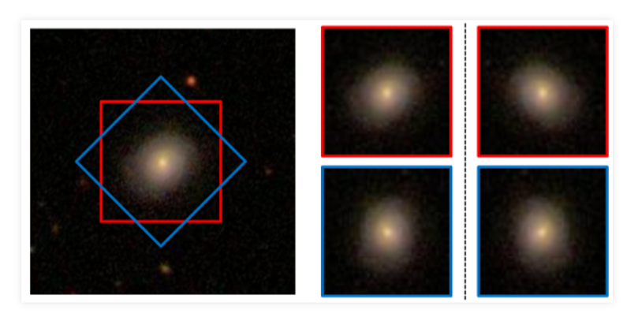
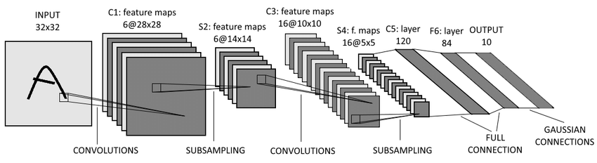
Solution
Preprocessing data
Generating more data
Training with Convolutional Neural Networks
Checking results and correcting parameters

